Slide 1

ISEC 2025 Final Assignment
Callahan o’quinn

Slide 2

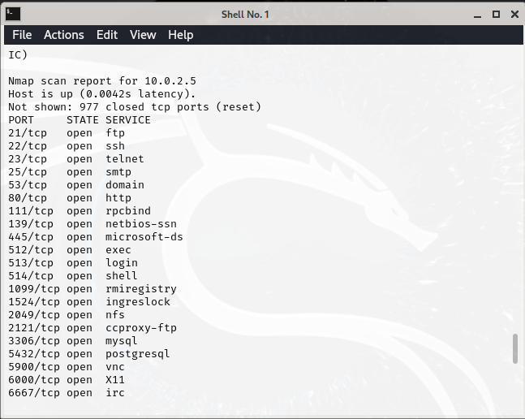


Flag: Show open ports & services running
Found ports & services running for the target by doing an nmap scan of the network

Slide 3
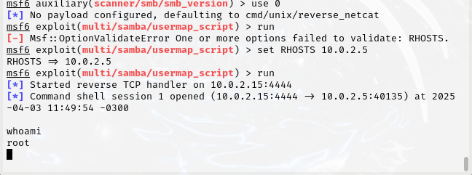


Flag: Gain root access
Used the scanner/smb/smb_version module to identify what OS version the target was running (Samba 3.0.2)
Searched for Samba 3.0.2 modules, used multi/samba/usermap_script to establish a shell connection to the target and gain root access

Slide 4
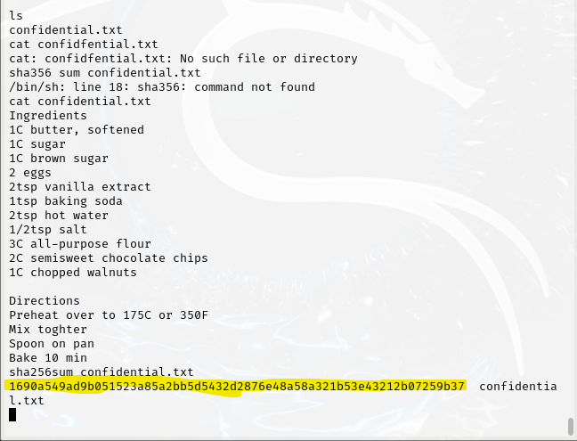


Flags: exfiltrate confidential.txt and identify its sha256 hash
Easily located confidential.txt by using ls (it was in /home/mastudent) – I stumbled upon it quickly by browsing, but I’m sure there's more efficient ways to comb through the target's files
Used cat to check the files delicious contents
Used sha256sum on the file to reveal its hash (highlighted)

Slide 5

Flag: read contents of supersecret file
Did some quick research on how to search for a file with an unknown extension -> used find / -iname ‘supersecret*’ to locate it (/root/supersecret)
source: https://unix.stackexchange.com/questions/362292/how-to-find-a-file-from-any-directory

Slide 6
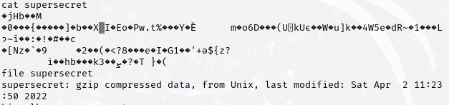
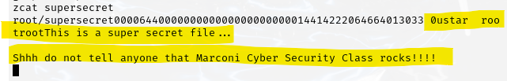

Flag: read contents of supersecret file
Using cat on the file reveals unreadable contents
Using the file command revelas the file is a gzip compressed file
Then by doing a little research on how to read the uncompressed contents, I tried a few commands until “zcat supersecret” revealed its contents (highlighted) source: https://www.gnu.org/software/gzip/manual/gzip.html

Slide 7
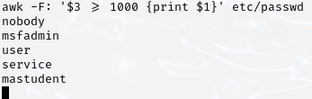

Flag: enumerate users
Doing some research, I found out that the users are listed in the passwd file so I used cat /etc/passwd which was not super readable
So by researching more, I used the “awk –F: ‘{print $1}’ /etc/passwd command to show a list all non-system users. Source: https://linuxize.com/post/how-to-list-users-in-linux/

Slide 8
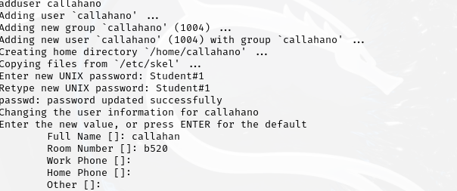


Flag: create a new user with root privileges
Used adduser to create a user with my name
Used “sudo usermod –aG sudo callahano” to add my user to the sudo group for root privilege
Verified I am now a member of the sudo group with the “getent group sudo” command

Slide 9


Flag: login with new credentials
Used “ su – callahano” to login to my new user & whoami to verify

Slide 10
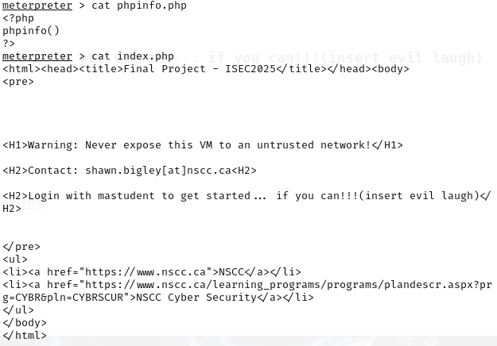
Flags: uploading a file to a server/ modifying the servers webpage
I decided to do both of these together as I was having an issue trying to use nano to edit the default webpages .php file
First I started a meterpreter session with the target
After doing some digging, I found that the servers default webpage was the index.php file in /var/www – Source: https://askubuntu.com/questions/413310/where-to-find-default-test-page-for-apache2

Slide 11
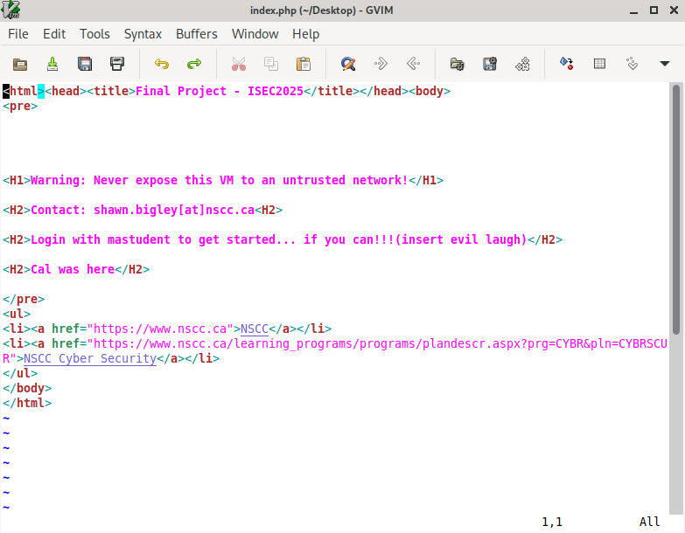
Flags: uploading a file to a server/ modifying the servers webpage
Next, I simply copied the html from index.php to a new text file on my ubuntu box. I added a header saying “Cal was here” and saved it to my machine as index.php

Slide 12


Flags: uploading a file to a server/ modifying the servers webpage
After saving the file, I took a shot in the dark by using the upload command in meterpreter. I was uncertain if it would work if I tried uploading a file where a preexisting one with the same name existed, but it appeared to work.
Source: https://www.offsec.com/metasploit-unleashed/meterpreter-basics/

Slide 13
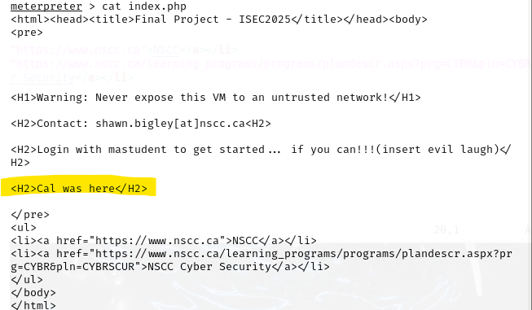
Flags: uploading a file to a server/ modifying the servers webpage
Using cat on index.php post upload showed that my uploaded file overwrote the original.

Slide 14
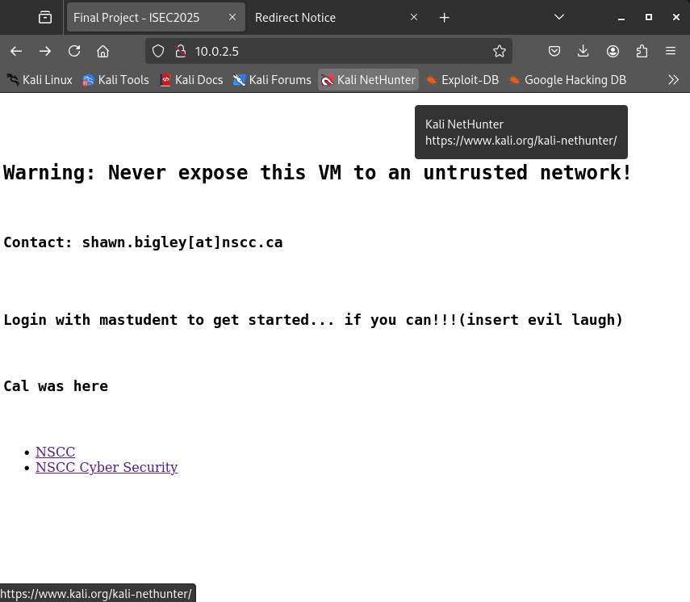



Flags: uploading a file to a server/ modifying the servers webpage
Now when I open the default webpage for the server (http://10.0.2.5), my changes are displayed:

